Slide 1
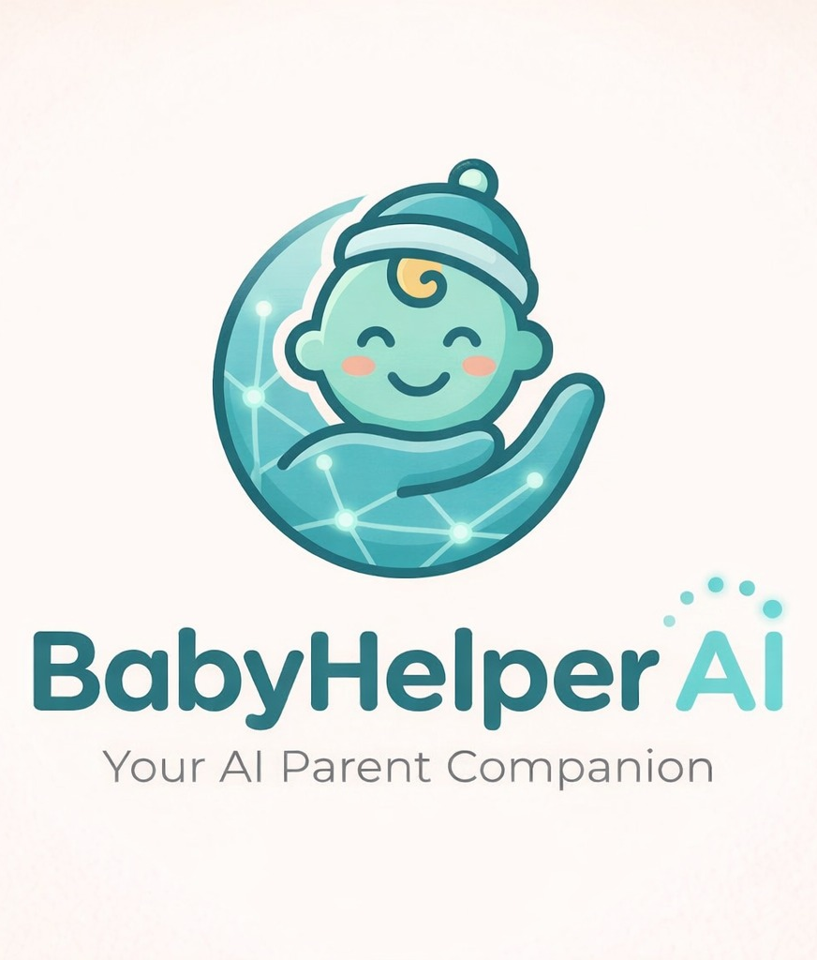
BabyHelper
AI
Supervised by:
Sir Emad AMJAD

Slide 2

Group Members:
Ihsan Ullah Khan
Mir Muhammad Zeeshan
Tayyab Khalid

Slide 3


Table of Contents:
o1.
Introduction
o2.
Proposed Approach
o3.
Existing Solutions
o4.
Solution: BabyHelper AI
o5.
Functional Requirements
o6.
Non-Functional Requirements
o7.
System Diagrams
o8.
Testing Overview & Future Work
o9.
Conclusions

Slide 4

INTRODUCTION:
How can we support infant's development?
BabyHelper AI is an innovative mobile application. It assist first-time parents in understanding and tracking their baby's needs and development.

Slide 5
PROPOSED APPROACH
Overall Strategy
1. Develop a unified 4-in-1 mobile health application
2. Integrate ML models for infant cry classification
3. Use WHO-standard analytics for growth monitoring
4. Design nutrition plans aligned with age appropriated foods
Technical Approach
1. Audio pre-processing → YAMNet/TFLite cry prediction
2. Growth data entry → WHO z-score calculation → growth assessment
3. Sleep session logging → statistical analysis → visual sleep charts & insights
4. Age-based infant data → meal recommendations → nutrition guidance

Slide 6
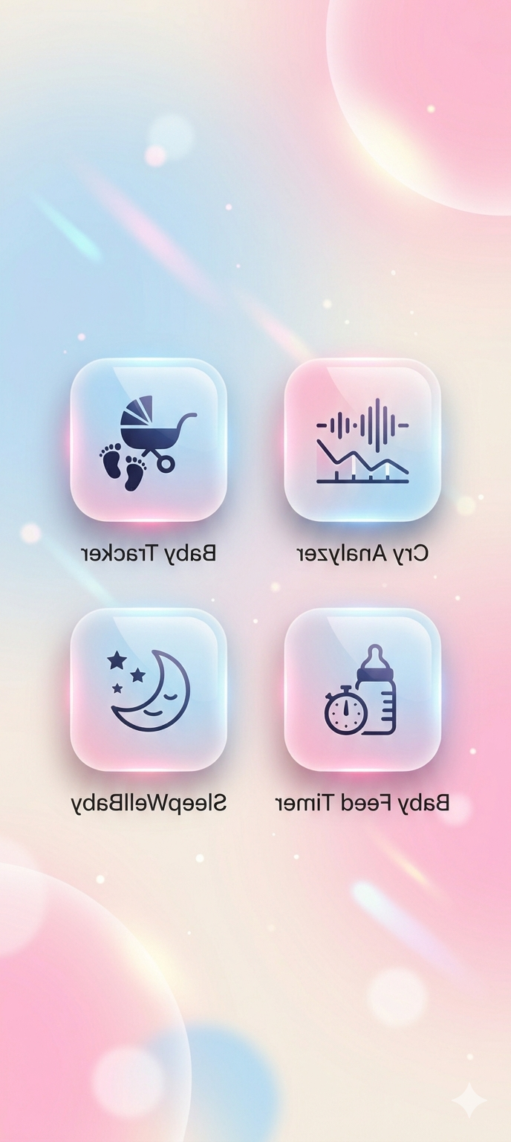
Existing Solutions
Cry Analyzer: Many users report that the apps often provide incorrect or inconsistent analyses of baby cries.
Baby Tracker: Only provides feeding, sleep, and diaper changes Information.
Baby Feed Timer: Interface not user friendly, annoying adds. Report of bugs.
SleepWellBaby: Paid version available only. Limited to only Sleep.

Slide 7
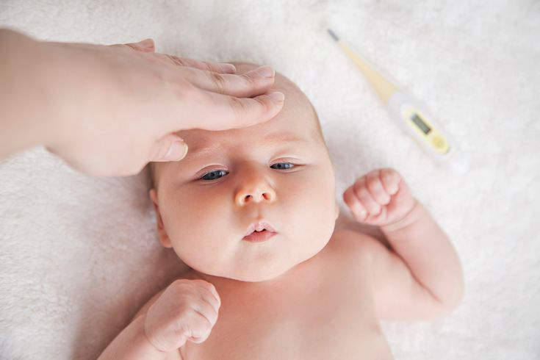


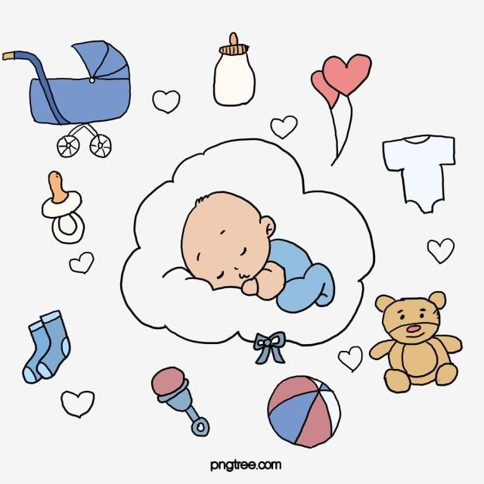
BabyHelper_AI
Growth Analysis
AI-Driven Cry Analysis
Nutrition Tracking
Sleep Pattern Monitoring

Slide 8

Functional Requirements
User Authentication: Secure login & registration using Firebase
Cry Analysis: Record infant cry & predicts cry category i.e Hunger, Discomfort, Tired etc
Growth Tracking: Input: weight, height, head circumference
Nutrition Guidance: Provide age-based meal plans.
Sleep Monitoring: Log sleep/wake time. Calculate daily sleep duration & Visualize patterns
View charts and reports: View weekly/monthly reports, Visualize patterns. Track progress of infant

Slide 9

Non-Functional Requirements
Performance: Cry prediction in real-time
Security: Encrypted communication (HTTPS/SSL). Password hashing with Encrypt
Reliability: Offline mode for major features, Local SQLite storage support
Usability: Simple UI for parents. Material Design-based consistency
Feasibility: Works on devices with ≥ 4 GB RAM.
Maintainability: Easy to update and extend. Modular system structure.

Slide 10
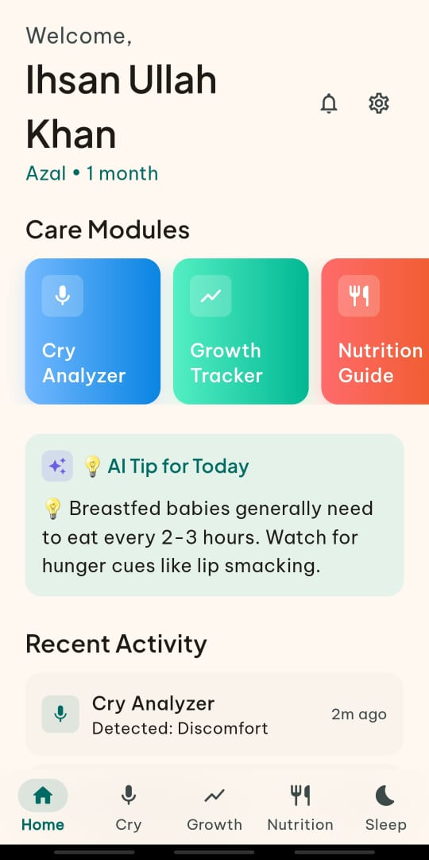
Modules of the project
Following are the modules used in our App
Audio Processing & prediction Module
Nutrition Guide Module
Growth Tracking Module
Sleep Monitoring Module

Slide 11
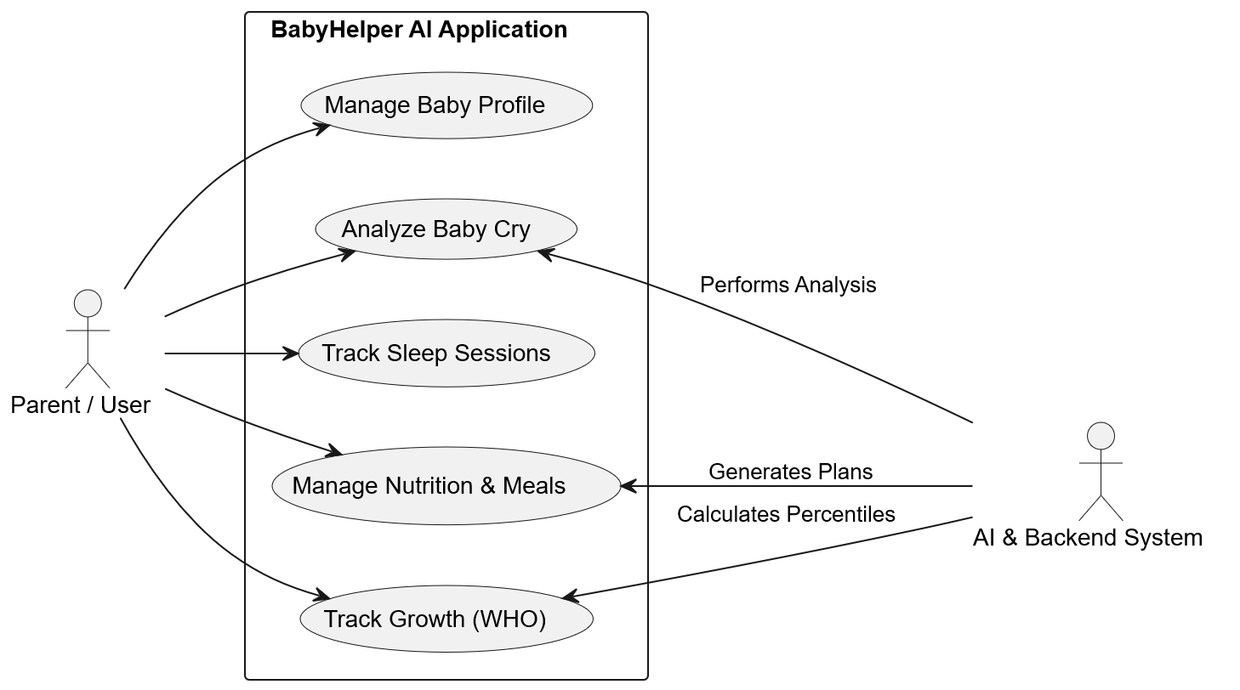
Use-Case Diagram

Slide 12
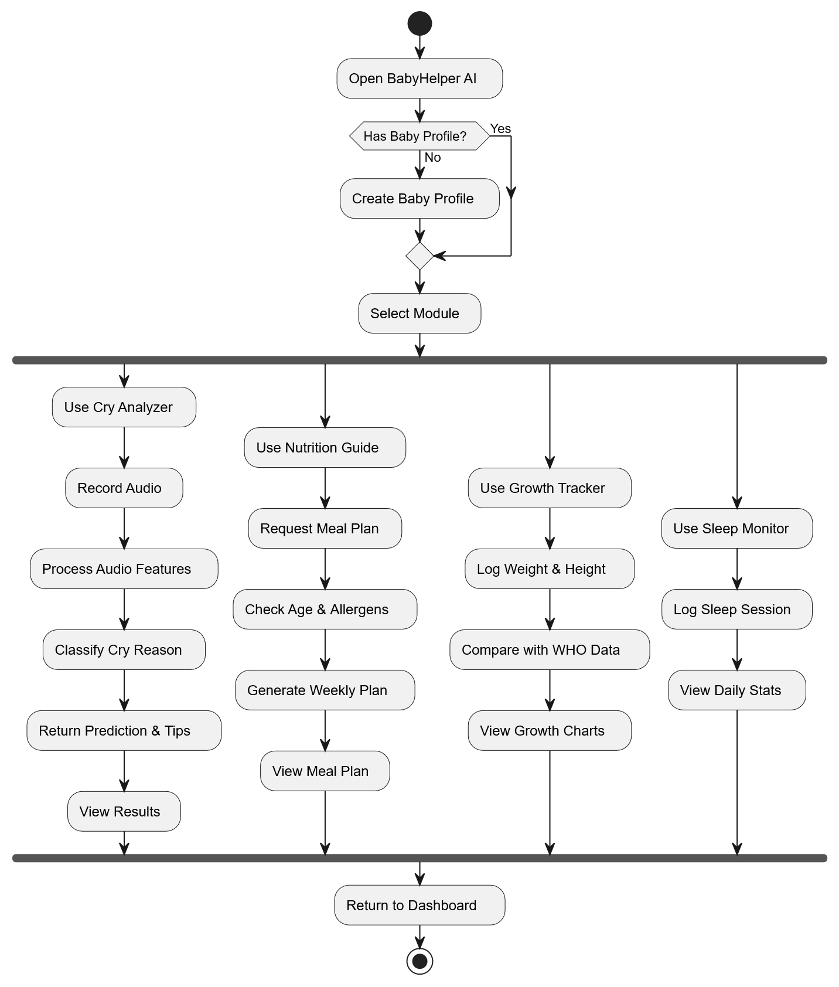
Activity Diagram

Slide 13
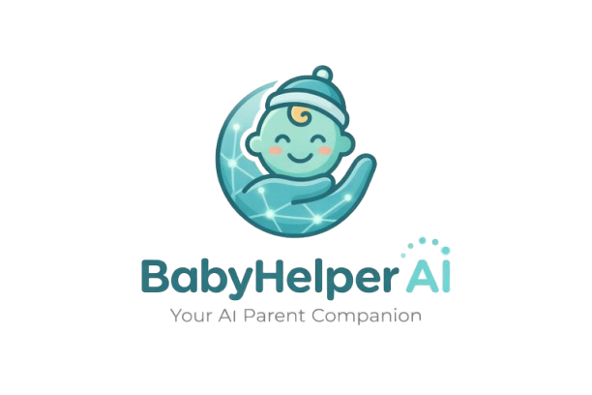
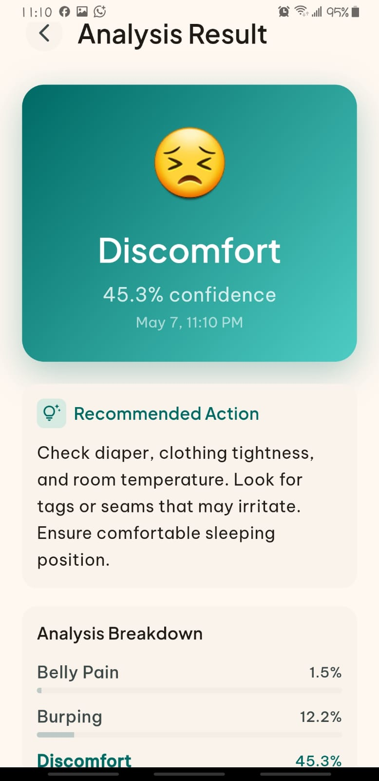
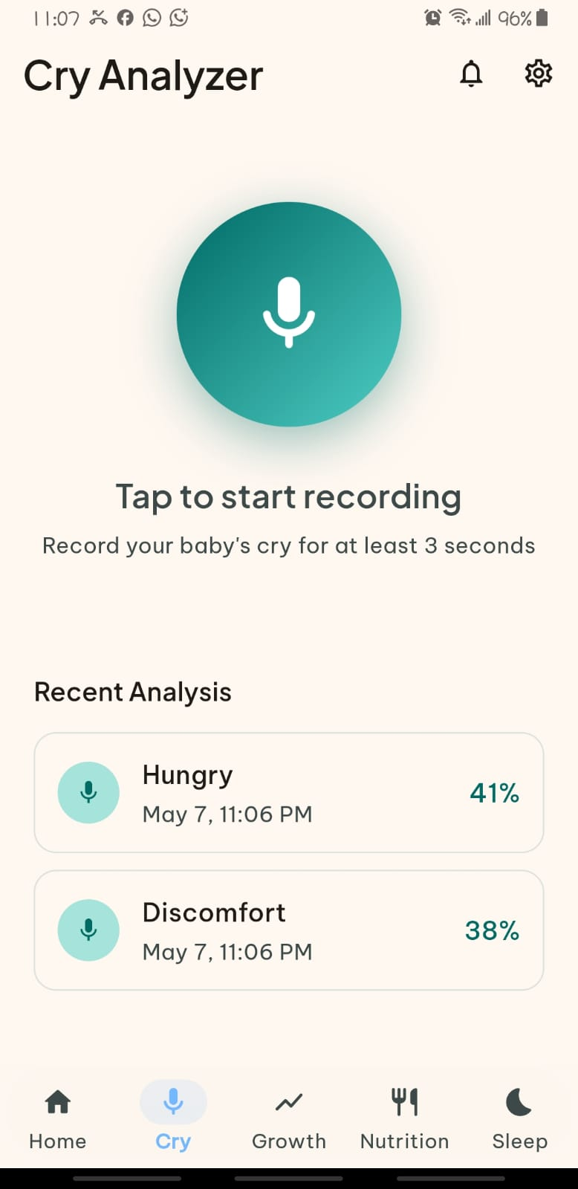
Real Time Testing

Slide 14

Testing Overview
Unit Testing: Tested each module like cry analysis and growth tracking separately.
Integration Testing : Verified communication between app, AI model, and database.
Manual Testing: Checked app functionality and usability on Android devices.
Data Validation: Ensured correct and accurate user input processing.
Edge Case Testing: Tested system behavior under unusual or invalid conditions.

Slide 15

Future Enhancements
Future advancements for BabyHelper AI
Larger cry datasets.
iOS deployment.
Multi-language support.
Improved AI accuracy.
Advanced analytics dashboard.
Smart notifications & reminders.

Slide 16

Limitations:
Following are the limits in our App
Limited cry dataset
AI confidence accuracy can be improved
Multi–platform focused deployment
Internet required for cloud sync

Slide 17

Conclusions
What we’ve discussed so far
BabyHelper AI provides an intelligent, integrated, and user-friendly infant-care solution for Pakistani parents. The system combines AI-powered cry analysis, growth monitoring, nutrition guidance, and sleep tracking into one platform to reduce parental stress and support informed caregiving

Slide 18

References
https://www.pinterest.com/pin/24558760464136743/
https://www.who.int/health-topics/nutrition#tab=tab_1
https://www.who.int/tools/your-life-your-health/life-phase/newborns-and-children-under-5-years/caring-for-newborns
https://www.who.int/data/gho/publications/world-health-statistics
https://www.pregnancybirthbaby.org.au/sleep-patterns-for-babies

Slide 19
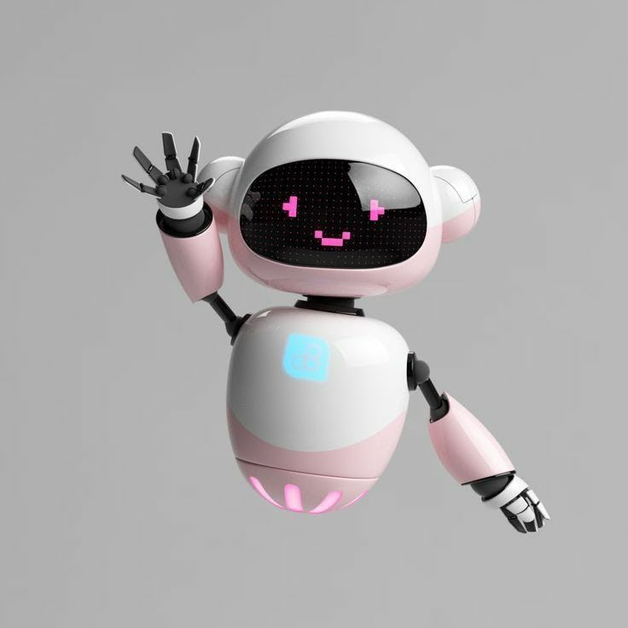
Thank you!

